Slide 1


Final Year Project
Computer On Wheels
Supervised By: Dr. Rizwan Bin Faiz (Assistant Professor)

Slide 2
Project Team
Bilal Rafiq (27661)
Hamza Azhar(28595)
Sardar Mohsin (28016)
M. Usama Nazir (30445)

Slide 3
Table of Content
Opportunity & Stakeholders
Solution
Progress Report Summary
Requirements
Software System (Design + Implementation + Testing)
Endeavour (Team + Work + Way of Working)
Next Steps
Prototype/Report

Slide 4
Opportunity & Stakeholders

Slide 5
Opportunity(1/3)
According to a National Highway Traffic Safety Administration (NHTSA) study, driver error led to 94% of the crashes examined.
According to the U.S. General Services Administration (GSA), human error causes 98% of crashes.

Slide 6
Opportunity (2/3)
A 2017 study by RAND Corporation found that self-driving cars could reduce traffic fatalities by up to 25% by 2040.
A 2019 study by the National Highway Traffic Safety Administration (NHTSA) found that self-driving cars were involved in fewer crashes than human-driven cars per mile driven.
A 2020 study by the Massachusetts Institute of Technology (MIT) found that self-driving cars could prevent up to 90% of crashes caused by human error.

Slide 7
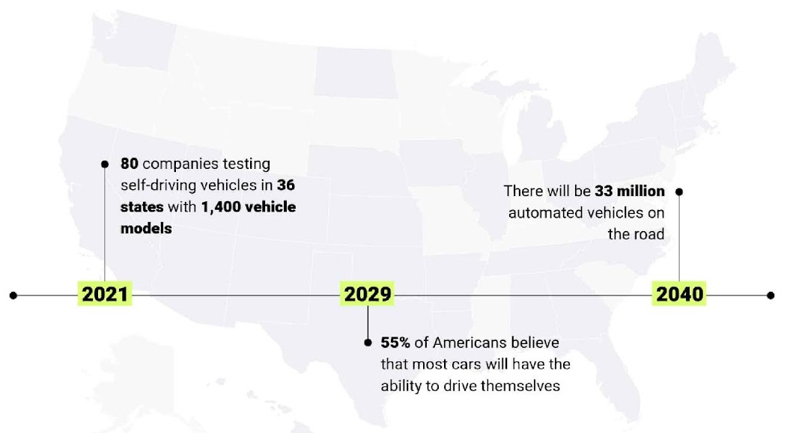
Opportunity (3/3)

Slide 8
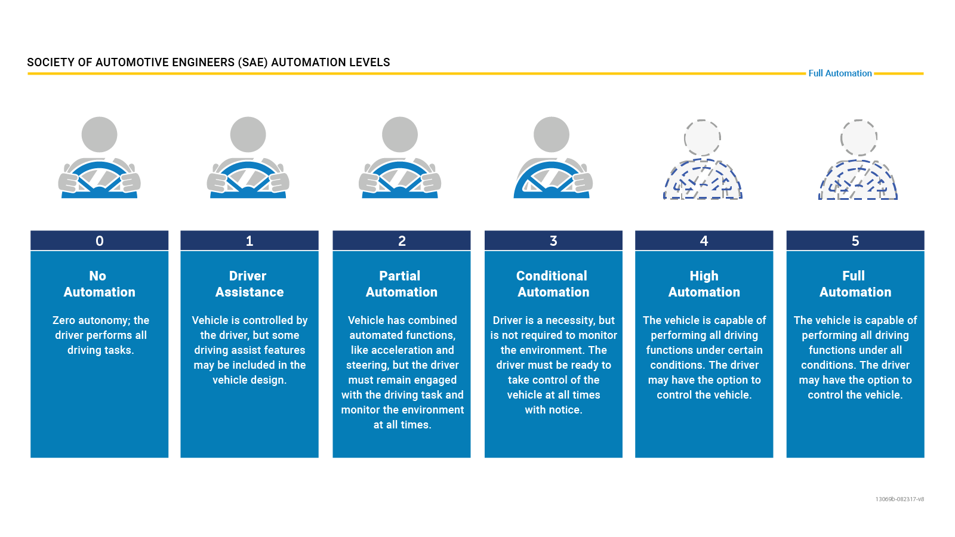
Levels of Autonomous Vehicle
Notes:
The Society of Automotive Engineers (SAE) International has defined six levels of driving automation, ranging from Level 0 (no automation) to Level 5 (full automation). As of today, only Levels 0, 1, and 2 are commercially available in production vehicles.

Slide 9
Stakeholders
Driver/Car
Passengers

Slide 10
Solution
We propose a software which makes the vehicle partially autonomous, featuring path planning(shortest path), path following, obstacle detection, dynamic avoidance for safe navigation in Urban Environment.

Slide 11
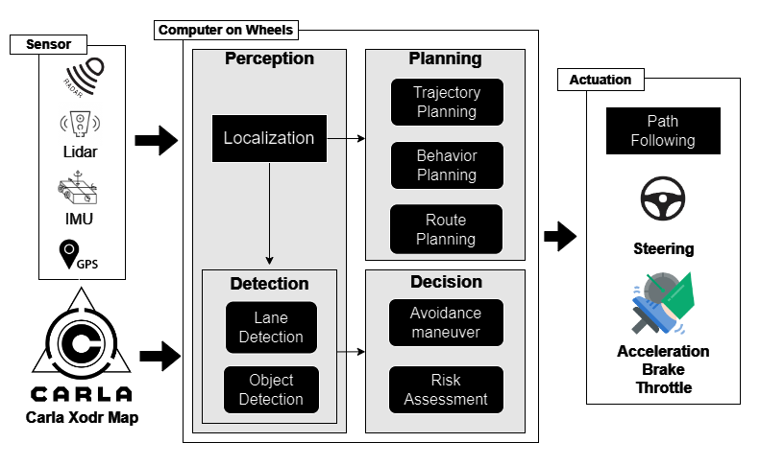
Solution

Slide 12
PROGRESS REPORT Summary

Slide 13
Requirements
Elicitation Techniques / Tools
Interviewing Domain Expert Interviews
Document Analysis
Notes:
While Interviewing Domain expert we have noted our Questions and created a Questionnaire like which Questions were asked at the time of meeting In Document Analysis we have gathered our requirements through Research articles.

Slide 14
Specification /Documentation (Artifacts):
Appendix-A: Software Requirements Specifications
Appendix-B: Design Artifact(Documentation)
Appendix-C: Coding Standards/Convention
Appendix-D: SQA Activities
Appendix-D1 Inspection Through Checklist
Appendix-D2 Scenario Based Test Cases
Appendix-D3 White Box Testing
Appendix-E: Work Breakdown Structure
Appendix-F: Roles & Responsibility Matrix

Slide 15
Specification /Documentation (Artifacts):
Questionaries:
Questionaries for Gathering requirement
Questionnaire for Technical Feasibility and Risk Assessment
Questionnaire for Tools and Technologies
SWOT analysis
Progress Report

Slide 16
List of Different Users
Driver
Passengers
Notes:
Car is not the use, the system is integrated within the car hence ultimately coming a part of car.

Slide 17
Requirements
Functional Requirements:
There are total 35 Functional requirements (potential scope). Among which we have implemented 19 Requirements. These requirements are Mentioned in SRS and Report.
Notes:
Highlighted requirements are the implemented one in part 1

Slide 18
Requirements
Non-Functional Requirements:
There is only 1 non-Functional requirement in our Project. Which we have gathered and analyzed though Research articles.
Notes:
Based on research paper, we only have this one NFR

Slide 19
Design
Architecture Diagram
Detailed Design:
Use case Diagram
Detailed Use cases
Activity Diagram
Sequence Diagram
Deployment Diagram
Notes:
All based on implemented requirements of part 1 (From architecture to sequence)

Slide 20
Design
Architecture Diagram:
The architecture model that is the best fit for our system and we have designed is based on Layered Architecture Diagram.

Slide 21
Design
Use Cases
There are Total 13 use cases designed for our project these use cases are explicitly shown in our Report, as we are following incremental approach these use cases are only of final year project part 1. Keeping their traceability inline against requirements.
Notes:
This is the use case of only the implemented requirements means part 1

Slide 22
Implementation
List Development Tools, Technologies & Platforms
List Best Practices / Coding Standards
List Libraries / Components

Slide 23
Implementation
List Development Tools, Technologies & Platforms
Tools
GitHub
Jira
Microsoft office
Visual Paradigm
Anaconda

Slide 24
Implementation
Technologies
Carla Simulator
Carla-Ros-Bridge
Rospy
Gazebo
Robot_localization
Python

Slide 25
Implementation
Platforms
Ubuntu
ROS Noetic

Slide 26
Implementation
Coding Standards
1. Python coding Standards
Use snake_case for variable and function names.
Use CamelCase for class names.
Follow PEP 8 guidelines for code formatting.
Use meaningful variable and function names.
Keep lines of code within 79 characters.

Slide 27
Implementation
Coding Standards
1. Python coding Standards
Use comments to explain complex parts of the code.
Use docstrings to document modules, classes, and functions.
Avoid using global variables unless necessary.
Handle exceptions gracefully.
Use virtual environments to manage dependencies.

Slide 28
Implementation
Coding Standards
2. Rospy coding Standards
Follow Python coding standards for rospy code.
Use rospy naming conventions for nodes, topics, and services.
Utilize rospy log functions for logging messages.
Ensure ROS dependencies are properly declared in package.xml and CMakeLists.txt.
Document ROS nodes, topics, and services using ROS comments.

Slide 29
Implementation
Coding Standards
2. Rospy coding Standards
Use rospy's rospy.spin() to keep the node alive.
Handle ROS messages and services according to their specifications.
Use rospy's parameter server for managing node parameters.
Implement proper error handling for ROS communication.

Slide 30
Implementation
List of libraries:
rospy (for ROS-based development)
NumPy (for numerical computations)
math (for mathematical operations)
keyword (for parsing Python keywords)
xmltodict (for handling XML data)
os (for interacting with the operating system)

Slide 31
Implementation
List of libraries:
carla_msgs (for CARLA-specific ROS messages)
sensor_msgs (for sensor-related ROS messages)
OpenCV (for computer vision tasks)
Pandas (for data manipulation and analysis)
Matplotlib (for data visualization)
TensorFlow or PyTorch (for deep learning, if applicable)
Gazebo (for simulation, if using alongside CARLA)
RViz (for visualization in ROS)

Slide 32
Implementation
List of Components:
Map Parser
Traffic Generator
Path Planner
Trajectory Follower
Obstacle Detector
Obstacle Avoider

Slide 33
Implementation
List of Components:
Localization Module
Sensor Data Fusion
Control System
Decision-Making Module
Simulation Environment

Slide 34
Testing
SRS => Defect Identification:
Inspection Through Checklist (D1)
System Design => Defect Identification:
Scenario based test cases (D2)
Implementation => Defect Identification:
White Box Testing (D3)

Slide 35
Endeavour
Describe roles of your team members
Describe your software development process
Describe your way of working as a team

Slide 36
Software Development Process
Software Engineering Practice:
In our project, we adopted a comprehensive and systematic approach to software engineering practices to ensure the delivery of a scalable and maintainable autonomous vehicle software system. Our methodology was influenced by industry best practices and tailored to meet the specific needs of our project. Key practices included:
Feature-Driven Development

Slide 37
Software Development Process
Feature-Driven Development:
We implemented the Feature-Driven Development (FDD) methodology which falls under the umbrella of Agile methodologies to manage our workflow efficiently and adapt to changing requirements. Utilizing Jira as our project management tool, we maintained a visual feature list and tracked progress seamlessly. Our agile approach included:

Slide 38
Software Development Process
Feature-Driven Development:
Feature List Management: Created and maintained a comprehensive feature list that broke down the system into small features. This list served as the backbone of our development process, guiding incremental and iterative development.
Incremental Development: Emphasized continuous and iterative development, delivering small, functional parts of the project regularly. This approach allowed for frequent validation, adjustment, and integration of new requirements.

Slide 39
Software Development Process
Feature-Driven Development:
Regular Supervisor Meetings: Conducted weekly meetings with supervisors to review progress, address challenges, and incorporate feedback. These meetings ensured alignment with project goals and facilitated timely decision-making

Slide 40
Endeavour
Incremental Development: Features were developed in small, manageable increments.
Continuous Integration: Regular integration and testing ensured quality and early defect detection.
Collaborative Effort: Teams worked closely to ensure efficient communication and alignment.

Slide 41
Endeavour
Rigorous Testing: Consistent testing and code reviews maintained high standards.
Comprehensive Documentation: Detailed documentation was maintained for transparency and future maintenance.

Slide 42
Endeavour
Way of working as a team
Interviewing Stakeholders
Ad-hoc meetings
Version Control: GitHub
Project Management: Jira Issue Tickets
File Sharing: Google Drive/WhatsApp
Online Meetings: Google Meet
Notes:
Ad-hoc: Ideal for addressing unexpected issues or clarifying doubts that arise during feature development or code reviews.

Slide 43
Endeavour
Way of working as a team
Industry Workspace Collaboration
Feedback from Industry Employees
Interaction with Domain Experts
Knowledge Sharing Sessions
Code Reviews

Slide 44
Endeavour
Way of working as a team
Retrospectives Meetings
Continuous Learning and Development Sessions
Milestone Reviews
Emails
Feedback Loop: Regular Performance Reviews
Notes:
Conduct retrospective meetings at the end of each sprint to reflect on what went well, what didn’t, and how processes can be improved.

Slide 45
NEXT STEPS

Slide 46
Work Breakdown Structure (List of all Deliverables / Strikethrough Completed Deliverables)
Project Management
1.1 Jira Project Management Tool
1.2 Work Breakdown Structure (WBS)
1.3 Roles & Responsibility Matrix
1.4 Change Control Plan
1.5 Meeting minutes and Progress report
Reports / Documentation
2.1. Team Members and Project Proposal
2.2. Project Proposal Document
2.2.1. Opportunity and Stakeholders
2.2.2. Challenges Goals and Objectives
2.2.3. Solution Overview diagram
2.2.4. Report Outline
2.3. Literature / Market Survey
2.3.1 Domain Expert Interview Findings
2.3.2 Questionnaire for Technical Feasibility and Risk Assessment
2.3.3 Brainstorming diagram
2.3.4 Academic Research Review
2.3.5 Gap analysis summary
2.3.6 Technology Landscape
2.3.6.1 SWOT analysis
2.3.7 Questionnaire for Selecting tools and techniques
2.3.8 Specialization - 4 courses series from Coursera

Slide 47
Work Breakdown Structure (List of all Deliverables / Strikethrough Completed Deliverables)
2.4 Requirement Analysis
2.4.1 Problem Scenarios
2.4.2 Requirement Elicitation
2.4.3 Questionnaire for gathering requirements
2.4.4 Functional Requirements
2.4.5 Non-Functional Requirement
2.4.6 Inspection Report
2.4.7 Software requirement specification artifact
2.5 System Design
2.5.1 Architecture Diagram
2.5.2 Use Case Diagram
2.5.3 Detail Use Cases
2.5.4 Activity Diagrams
2.5.5 System Sequence Diagram
2.6 Implementation
2.6.1 Components and Libraries
2.7 Testing and Performance Evaluation
2.7.1 Test Scenarios
2.8 Conclusion & Outlook
2.8.1 Future Recommendations
2.9 Progress Presentation
2.9.1 Slides outlining project progress
2.9.2Updated Artifacts

Slide 48
Work Breakdown Structure (List of all Deliverables / Strikethrough Completed Deliverables)
2.9.2.1 Appendix-A: Software Requirements Specifications (SRS)
2.9.2.2 Appendix-B: Design Documents
2.9.2.3 Appendix-C: Coding Standards/Conventions
2.9.2.4 Appendix-D: Test Scenarios
2.9.2.5 Appendix-E: Work Breakdown Structure
2.9.2.6 Appendix-F: Roles & Responsibility Matrix
2.9.3 Answers to potential questions report
2.10 Final Presentation part 2
2.10.1 Comprehensive Slides for presentation
2.10.2 Working software system (Complete)
2.10.3. Updated Artifacts (Complete)
2.10.3.1. Appendix-A: Software Requirements Specifications (SRS)
2.10.3.2. Appendix-B: Design Documents

Slide 49
Work Breakdown Structure (List of all Deliverables / Strikethrough Completed Deliverables)
2.10.5 Final Report
3. System
3.1 Development Environment
3.1.1. IDE
3.1.1.1. Visual Studio Code
3.1.1.2. PyCharm
3.1.2 Version Control
3.1.2.1. Git Hub
3.1.3 Environment Management
3.1.3.1. Anaconda Distribution
3.2 Simulation Environment Setup
3.2.1 CARLA Simulator
3.2.1.1. Carlaviz for CARLA Visualization
3.2.2. ROS Noetic Configured
3.2.3. CARLA-ROS Bridge Integrated
3.2.4. Vehicle spawn module
3.2.5. Sensor spawn module
3.2.6. Destroy Vehicle module
3.3 Path Planning component
3.3.1. Map Reading module
3.3.2. Graph of Roads
3.3.3. Graph of Lanes
3.3.4. List of Driving Lanes within map

Slide 50
Work Breakdown Structure (List of all Deliverables / Strikethrough Completed Deliverables)
3.3.5. Route Calculation module
3.3.6. Algorithm implementation module
3.3.7. Global route planner module
3.3.8. Axis Translation module
3.3.9. Local route planner module
3.3.10. Environment Analysis module
3.3.11. Trajectory Generation module
3.3.12. Junction handling module
3.4. Path Following component
3.4.1. Trajectory Tracking module
3.4.2. Basic agent module
3.4.3. Behaviour agent module
3.4.4. Algorithm implementation module
3.4.5. Controller module
3.4.6. Custom Destination module
3.5. Vehicle Control component
3.5.1. Throttle Control module
3.5.2. Braking Control module
3.5.3. Acceleration Control module
3.5.4. Steering Control module
3.5.5. Longitudinal Control module
3.5.6. Lateral Control module
3.5.7. Lane changing module
3.5.8. Jerkiness Control algorithm modules
3.5.9. Rotation and Translation module

Slide 51
Work Breakdown Structure (List of all Deliverables / Strikethrough Completed Deliverables)
3.5 Sensor Integration module
3.5.1 IMU integration sub-module
3.5.2 GPS integration sub-module
3.5.3 Radar integration sub-module
3.5.4 Lidar integration sub-module
3.6 Obstacle Detection
3.6.1. Sensor Fusion module
3.6.1.1. Lidar-Radar Fusion sub-module
3.6.1.2. Multi-sensor Data synchronization sub-module
3.6.2. Sensor Data Processing module
3.6.3. Obstacle Detection module
3.6.3.1. ML based detection sub-module
3.6.4. Distance Estimation module
3.6.5. Object Classification module
3.7 Obstacle Avoidance
3.7.1 Dynamic Obstacle handling module
3.7.2 Static Obstacle handling module
3.7.3 Path Adjustment module
3.7.3.1. Map based planning sub-module
3.7.3.2. Graph based planning sub-module
3.7.4. Trajectory Estimation module

Slide 52
Work Breakdown Structure (List of all Deliverables / Strikethrough Completed Deliverables)
3.7.5. Maneuver Planning module
3.7.5.1. Environmental evaluation sub- module
3.7.5.2. Lane changes sub-module
3.7.5.3. Decelerate sub-module
3.7.5.4. Emergency Stop sub-module
3.7.6. Real-time Response module
3.7.7. Tracking module
3.7.7.1. Kalman filter sub-module
3.7.7.2. Particle filter sub-module
4. Open House
4.1. Event Part 1
4.1.1. Standee Design
4.1.2. Printed Standee
4.1.3. Printed Broachers
4.1.4. Pre-recorded Demo video
4.2. Event Part 2
4.2.1. Standee Design
4.2.2. Printed Standee
4.2.3. Printed Broachers
4.2.4. Full Working Software

Slide 53
Challenges
1. Resource Intensive:
Requires significant computational resources (GPU) and specialized hardware for simulations and real-world testing.
Relying on external simulators and libraries can introduce vulnerabilities if there are updates. or changes beyond your control.
2. Complex Integration:
Integrating multiple technologies and ensuring seamless communication between them can be challenging.
.

Slide 54
Challenges
3. High Learning Curve:
The complexity of tools and frameworks such as ROS and CARLA may require significant training and ramp-up time.
4. Fear of system crash due to high load
5. Re-implementation of other algorithms

Slide 55
Prototype
Demonstration of actual working system

Slide 56
Report

Slide 57
Report
Chapter 1: Introduction
Chapter 2: Literature / Market Survey
Chapter 3: Requirement Analysis
Chapter 4: System Design
Chapter 5: Implementation
Chapter 6: Testing & Evaluations
Chapter 7: Conclusion & Outlook

